Slide 1
Title: Modern Natural selection
LO: To give examples of natural selection occurring in modern times
Copy and complete the passage below
Natural selection
_________________is where characteristics of an organism favours its___________, promoting that trait in _______ __________. The ‘fitter’ the organism the ________ chance it has of survival and passing on its alleles. This is known as survival of the _______
survival
future
generations
higher
fittest
future
higher
fittest
natural selection
generations
survival
Bronze: Describe what MRSA is
Silver: Use the process of natural selection to describe how the MRSA crisis has occurred.
Gold; Suggest ways we could overcome the problem of antibiotic resistance

Slide 2
LO: To give examples of natural selection occurring in modern times
Bronze: Describe what MRSA is
Silver: Use the process of natural selection to describe how the MRSA crisis has occurred.
Gold; Suggest ways we could overcome the problem of antibiotic resistance
Spec point 4.3
4.3 Explain how the emergence of resistant organisms supports Darwin’s theory of evolution including antibiotic resistance in bacteria

Slide 3



LO: To give examples of natural selection occurring in modern times
For each of the following slides, write down one word to represent what is happening
What does MRSA stand for?
Bronze: Describe what is meant by survival of the fittest (natural selection)
Silver: Explain why survival of the fittest leads to evolution by natural selection
Gold: Explain the impact of the idea of evolution on modern biology

Slide 4
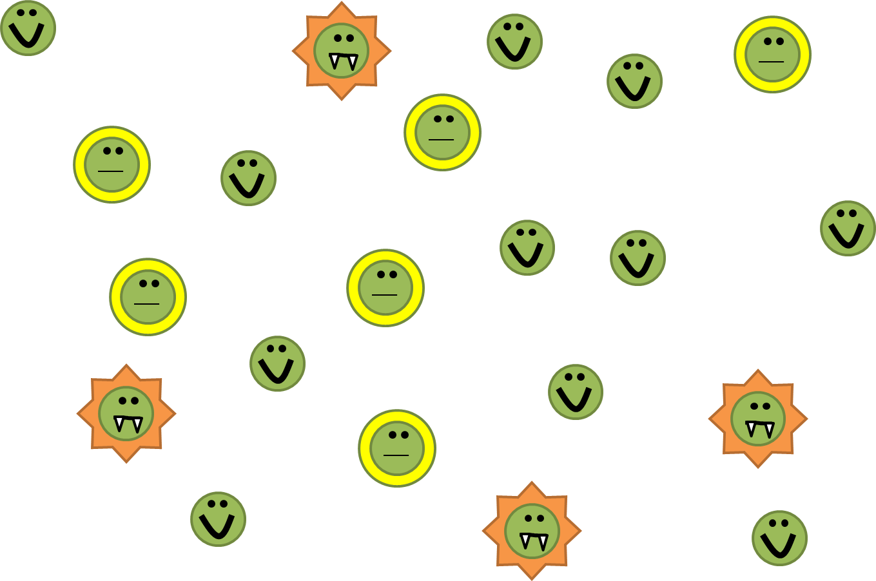
LO: To learn how evolution happens through natural selection
A population of bacteria with natural variation where some bacteria that are susceptible and some that are resistant.
Bronze: Describe what is meant by survival of the fittest (natural selection)
Silver: Explain why survival of the fittest leads to evolution by natural selection
Gold: Explain the impact of the idea of evolution on modern biology

Slide 5
LO: To learn how evolution happens through natural selection
The bacteria over-produced so there are more bacteria than needed to continue to population.
Bronze: Describe what is meant by survival of the fittest (natural selection)
Silver: Explain why survival of the fittest leads to evolution by natural selection
Gold: Explain the impact of the idea of evolution on modern biology

Slide 6
LO: To learn how evolution happens through natural selection
You start taking an antibiotic…
Bronze: Describe what is meant by survival of the fittest (natural selection)
Silver: Explain why survival of the fittest leads to evolution by natural selection
Gold: Explain the impact of the idea of evolution on modern biology

Slide 7
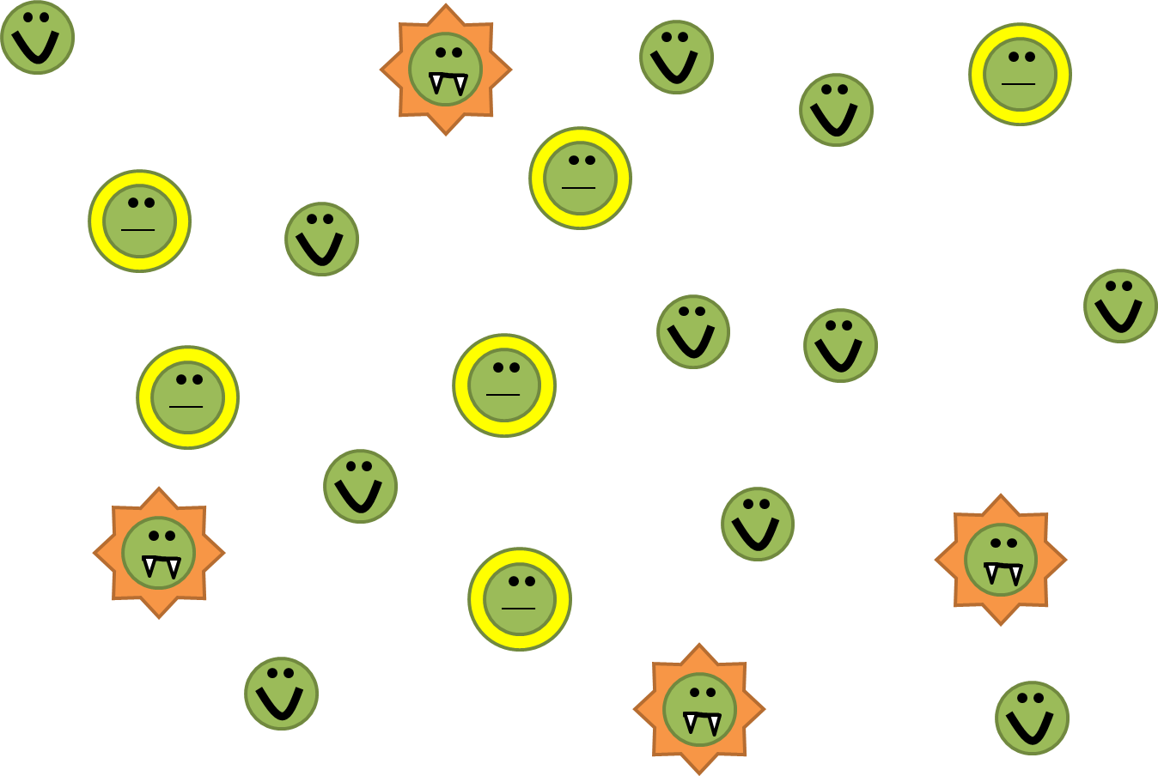
LO: To learn how evolution happens through natural selection
And the susceptible (weak) bacteria die first – the struggle for existence
Bronze: Describe what is meant by survival of the fittest (natural selection)
Silver: Explain why survival of the fittest leads to evolution by natural selection
Gold: Explain the impact of the idea of evolution on modern biology

Slide 8
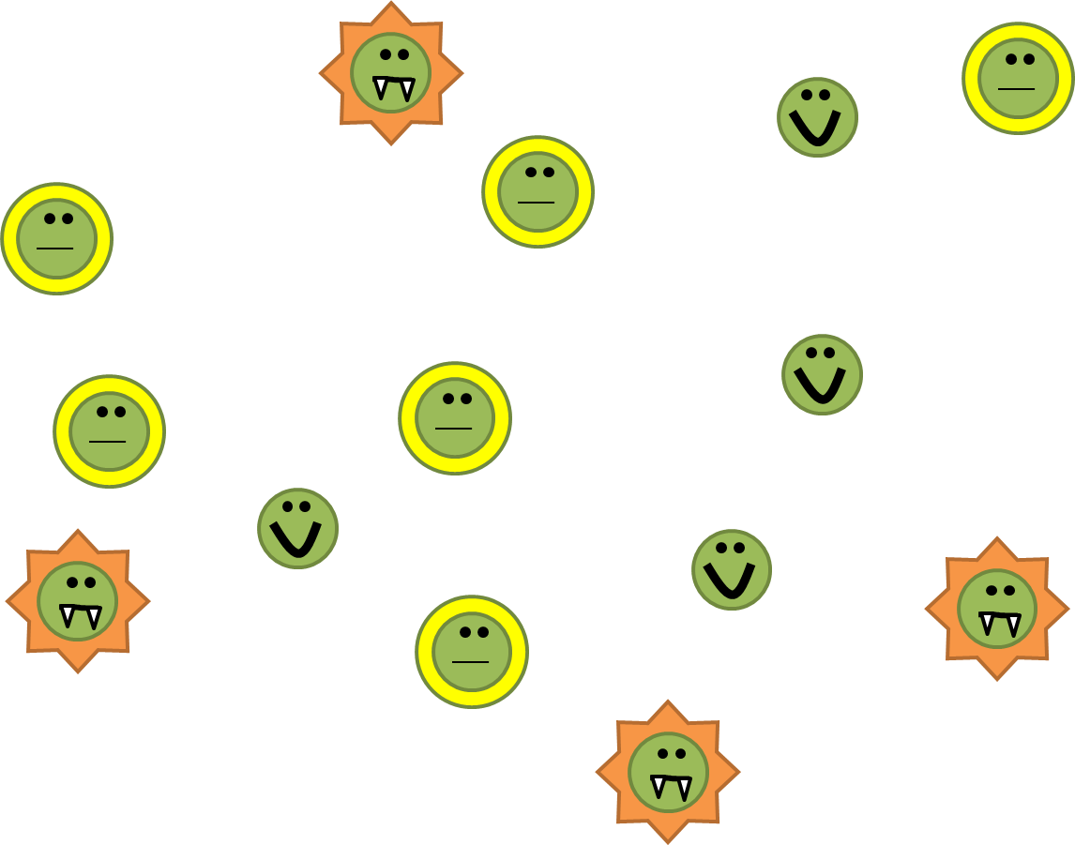
LO: To learn how evolution happens through natural selection
You keep taking the antibiotic, more bacteria die
Bronze: Describe what is meant by survival of the fittest (natural selection)
Silver: Explain why survival of the fittest leads to evolution by natural selection
Gold: Explain the impact of the idea of evolution on modern biology

Slide 9
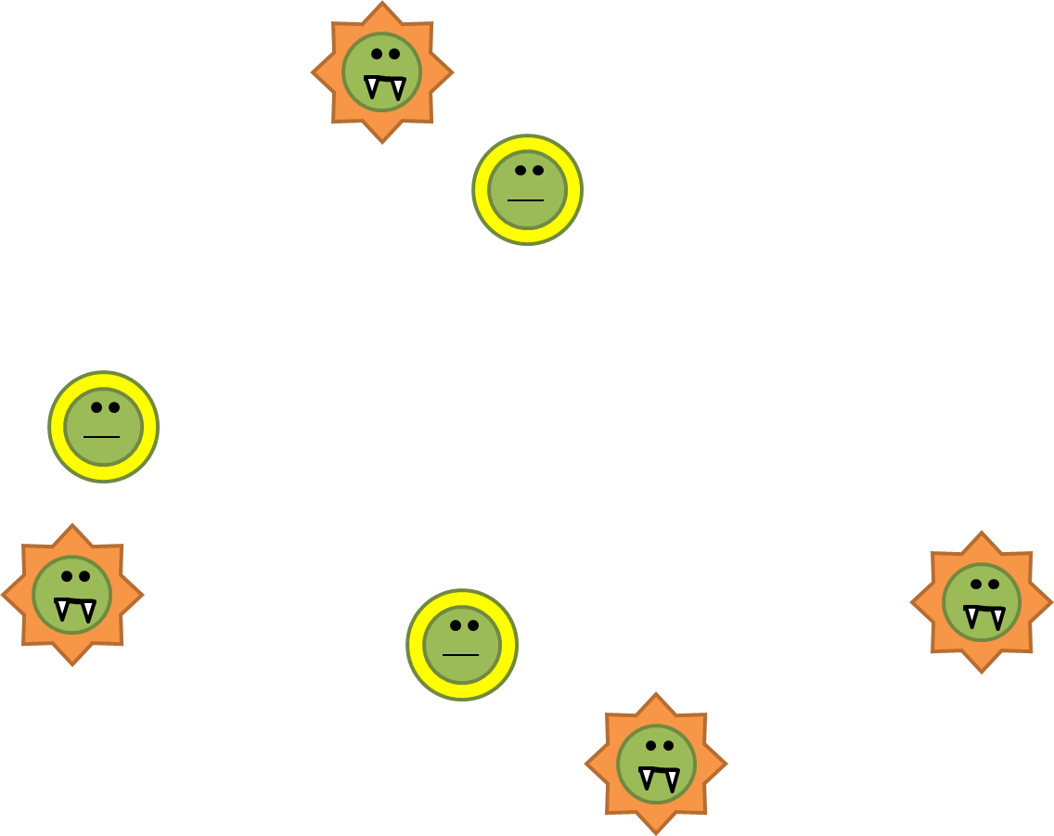
LO: To learn how evolution happens through natural selection
Until eventually only the resistant bacteria are left - survival
Bronze: Describe what is meant by survival of the fittest (natural selection)
Silver: Explain why survival of the fittest leads to evolution by natural selection
Gold: Explain the impact of the idea of evolution on modern biology

Slide 10
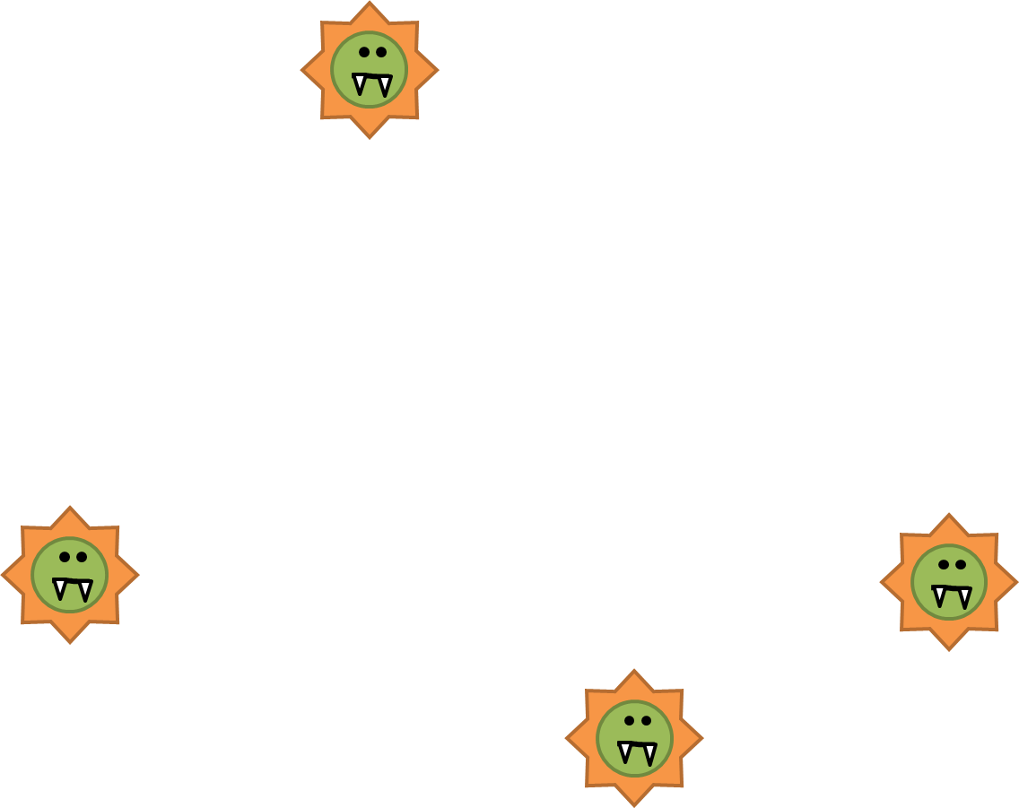
LO: To learn how evolution happens through natural selection
You stop taking the antibiotic
Bronze: Describe what is meant by survival of the fittest (natural selection)
Silver: Explain why survival of the fittest leads to evolution by natural selection
Gold: Explain the impact of the idea of evolution on modern biology

Slide 11
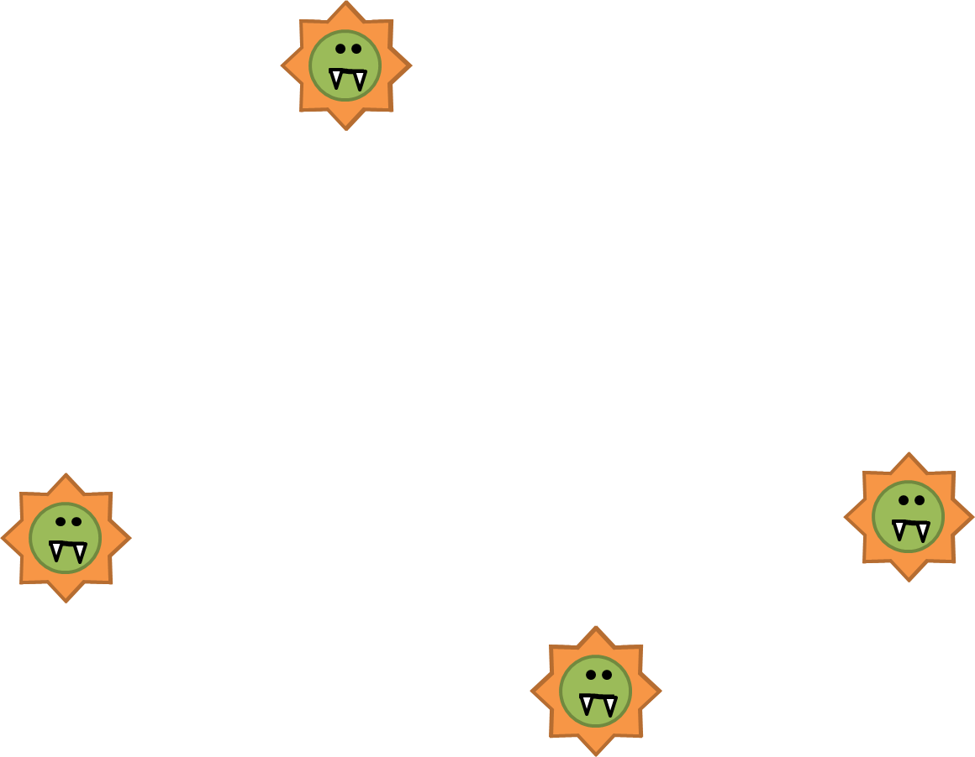
LO: To learn how evolution happens through natural selection
The resistant bacteria reproduce
Bronze: Describe what is meant by survival of the fittest (natural selection)
Silver: Explain why survival of the fittest leads to evolution by natural selection
Gold: Explain the impact of the idea of evolution on modern biology

Slide 12
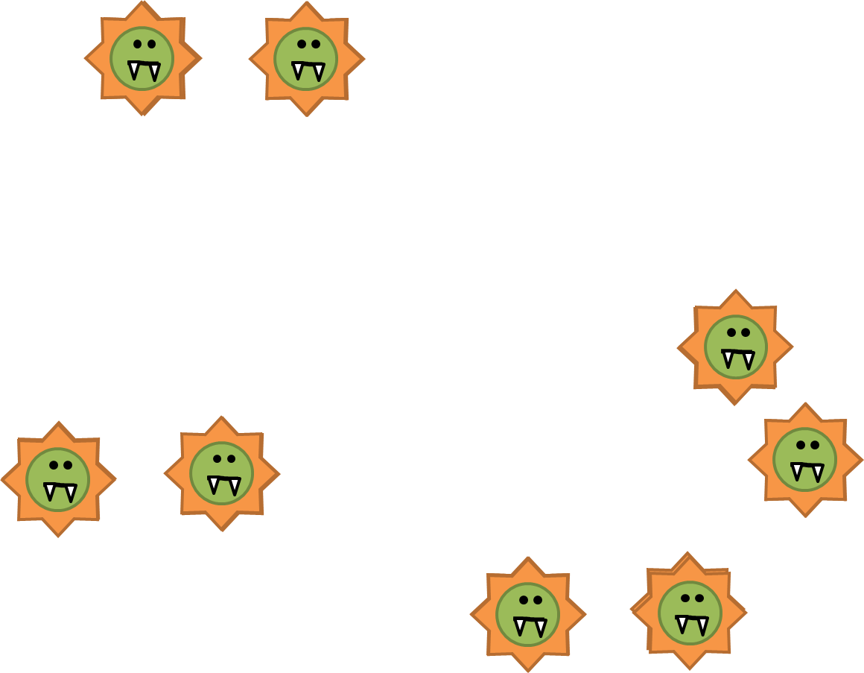
LO: To learn how evolution happens through natural selection
The resistant bacteria reproduce
Bronze: Describe what is meant by survival of the fittest (natural selection)
Silver: Explain why survival of the fittest leads to evolution by natural selection
Gold: Explain the impact of the idea of evolution on modern biology

Slide 13
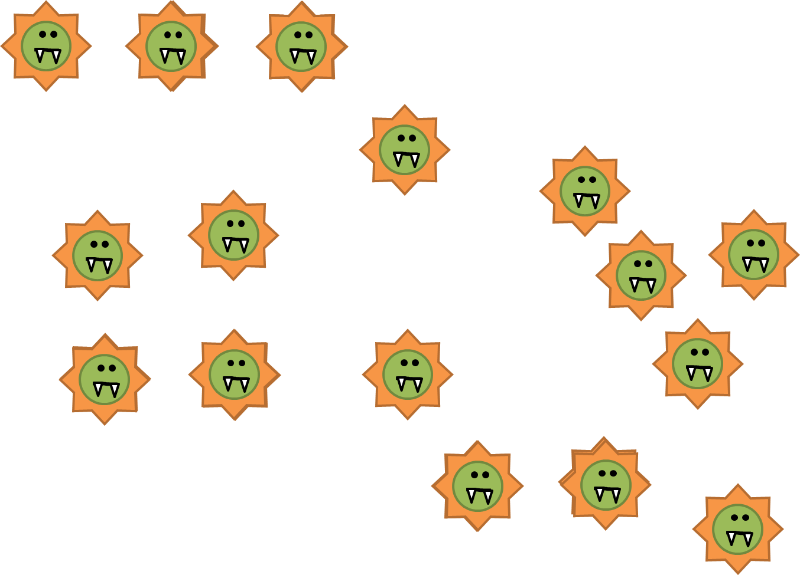
LO: To learn how evolution happens through natural selection
Bronze: Define mutation
Silver: Describe what is meant by survival of the fittest (natural selection)
Gold: Explain why survival of the fittest leads to evolution by natural selection
Now there are lots of resistant bacteria– the useful characteristic (coded for by an allele) that was passed onto offspring in this case in antibiotic resistance

Slide 14
LO: To learn how evolution happens through natural selection
If I take the antibiotic again, what happens? Or in other words, what was the gradual change you observed in this population?
Bronze: Describe what is meant by survival of the fittest (natural selection)
Silver: Explain why survival of the fittest leads to evolution by natural selection
Gold: Explain the impact of the idea of evolution on modern biology

Slide 15

LO: To learn how evolution happens through natural selection
Use what you wrote on your MWBs and your notes to write what happens at each stage (there are 8 in total)
There is natural variation in a population of bacteria (some have genes that are mean they are resistant to antibiotics and some do not).
2.
3.
4.
5.
6.
7.
8.
Include all the keywords (words in bold) from last lesson
Bronze: Describe what is meant by survival of the fittest (natural selection)
Silver: Explain why survival of the fittest leads to evolution by natural selection
Gold: Explain the impact of the idea of evolution on modern biology
Notes:
Please note that were more steps in the diagram to help illustrate natural selection but they need to summarise the process in 8 steps to be able to do their prep.

Slide 16

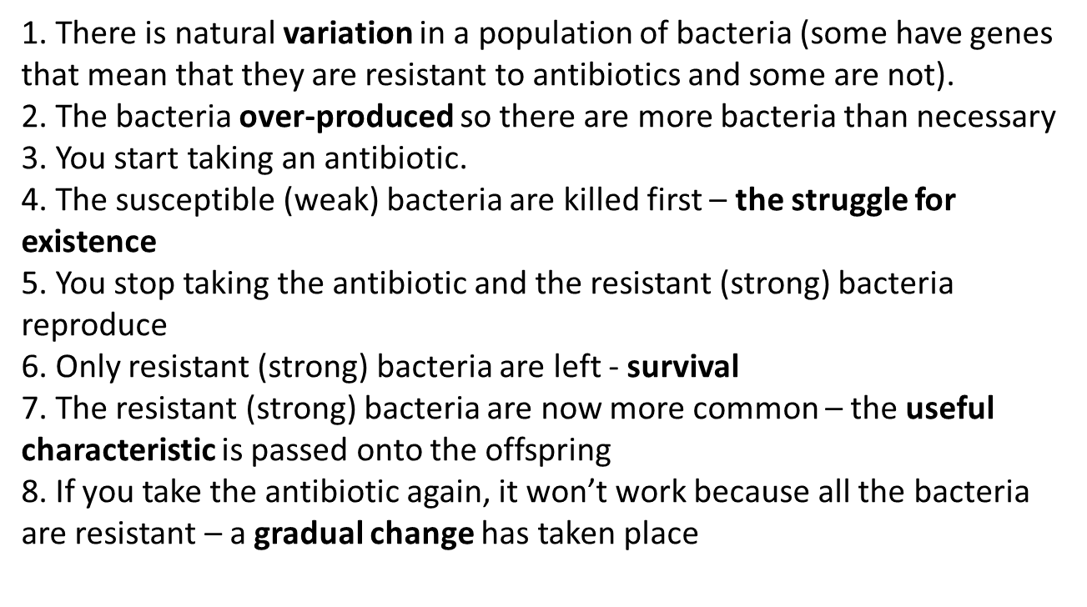
LO: To learn how evolution happens through natural selection
Read your/ your partner’s work and edit any silly mistakes.
Identify what medal is achieved and highlight the evidence.
Assess the work by writing one of the below comments.
Bronze: Describe what is meant by survival of the fittest (natural selection)
Silver: Explain why survival of the fittest leads to evolution by natural selection
Gold: Explain the impact of the idea of evolution on modern biology
Notes:
Get pupils to improve answers and then use that to do prep

Slide 17
LO: To learn how evolution happens through natural selection
Read your/ your partner’s work and edit any silly mistakes.
Identify what medal is achieved and highlight the evidence.
Assess the work by writing one of the below comments.
Bronze: Describe what is meant by survival of the fittest (natural selection)
Silver: Explain why survival of the fittest leads to evolution by natural selection
Gold: Explain the impact of the idea of evolution on modern biology
Notes:
Get pupils to improve answers and then use that to do prep

Slide 18
LO: To give examples of natural selection occurring in modern times
Watch the video
If you were director of the NHS, state what you would insist your nurses, doctors and patients do to reduce the MRSA spread
Doctors
Stop over prescribing antibiotics
Instruct all hospital staff to follow strict hygiene rules in hospital and GP surgery
Nurses
Always wash hand between seeing patients
Patients
Only take antibiotics when urgently needed
Take the full course of antibiotics
Wash your hands regularily when in hospital
Where could we find alternatives for antibiotics?

Slide 19
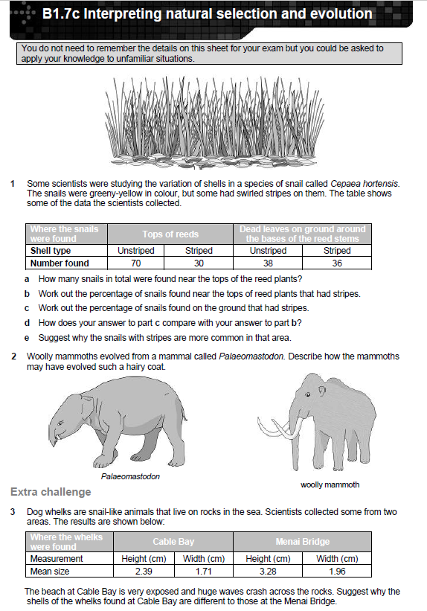
LO: To give examples of natural selection occurring in modern times
Self asses as a class
What does MRSA stand for?

Slide 20

LO: To learn how evolution happens through natural selection
Read your/ your partner’s work and edit any silly mistakes.
Identify what medal is achieved and highlight the evidence.
Assess the work by writing one of the below comments.
PREP TASK: Complete the exam questions
Bronze: Describe what is meant by survival of the fittest (natural selection)
Silver: Explain why survival of the fittest leads to evolution by natural selection
Gold: Explain the impact of the idea of evolution on modern biology
Notes:
Get pupils to improve answers and then use that to do prep

